Slide 1
FSW Canard Configuration in Level Flight (HA144A)
Static aeroelastic solution to the sample problem in the Nastran Aeroelasticity User Manual
Admir Makas

Slide 2
Introduction
Sample problem HA144A from the aeroelasticity MSC Nastran manual.
Solution type is 144 (Static aeroelasticity analysis)
Forward swept wing canard configuration considered
Fuselage and wing structure modelled using beam elements
There level flight conditions evaluated
Subsonic
Supersonic
Solutions obtained by following methods:
Doublet-Lattice (Subsonic)
ZONA51 (Supersonic)

Slide 3
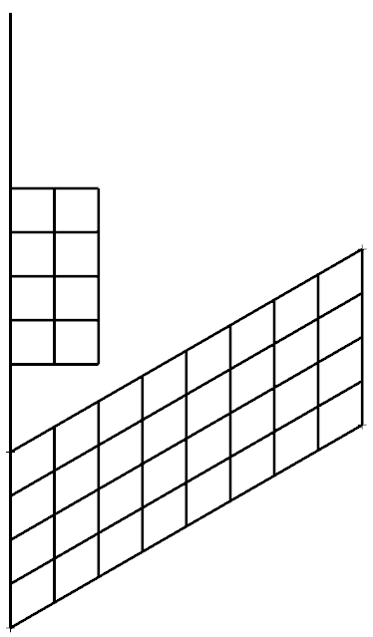
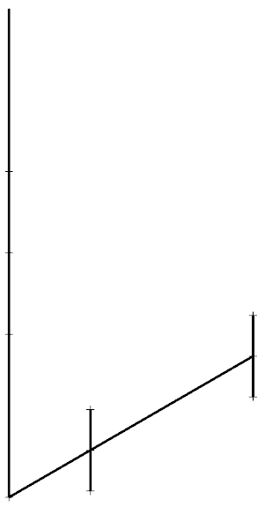
Model Details
Structural Model
(Modeled using beam elements)
Aerodynamic Model
M=1500
Canard:
Aspect ratio = 1
Chord = 10 ft
Latice Div = 4 by 2
0, 0, 0
Wing:
Aspect ratio = 4
Chord = 10 ft
Area = 200 ft^2
Latice Div = 8 by 4
M=1500
Reference node for rigid body modes
10, 0, 0
Length=30 ft
15, 0, 0
18.840, 15, 0
M=600
M=1500
24.613, 5, 0
20, 0, 0
M=600
21.340, 15, 0
Ang = 30
M=400
23.840, 15, 0
M=1500
30, 0, 0
M=400
27.113, 5, 0
29.613, 5, 0

Slide 4
Material Properties
Trim Conditions
Isotropic material:
E = 1.44x10^9 lb/ft^2
G = 5.40x10^8 lb/ft^2
Beam properties (FUSELAGE):
A = 2.0 ft^2
Iy = 0.173611 ft^4
Iz = 0.15 ft^4
J = 0.5 ft^4
Beam properties (WING):
A = 1.5 ft^2
Iy = 0.173611 ft^4
Iz = 2.0 ft^4
J = 0.462963 ft^4
TRIM 1 (Subsonic)
MACH = 0.9
Flight Dynamic Pressure (q) = 1200 lb/ft^2
TRIM 2 (Low speed characteristics):
MACH = 0.9
Flight Dynamic Pressure (q) = 40 lb/ft^2
TRIM 3 (Supersonic):
MACH = 1.3
Flight Dynamic Pressure (q) = 1151 lb/ft^2

Slide 5
Experimental Corrections
Considered example utilizes correction factor matrices, which are meant to account for the differences between test and theory.
MSC manual provides the values for the following matrices:
WKK = matrix of correction factors to adjust lift calculations [80 by 80 diagonal matrix]. In this example all diagonal values equal to 1. Off-diagonal values are zero.
W2GJ = vector defining the incidence of the lifting surface [1 by 40 vector]. In this example incidence of the wing is 0.1 Deg (0.0017453 Rad) while canard incidence is equal to 0 Deg. Therefore first 8 rows are set to zero (they correspond to the canard).
FA2J = vector defining additive experimentally obtained pressure coefficient terms. In this case this vector is set to 0 for all rows.
The size of the matrices and vectors are based on the number or boxes defined for the aerodynamic model. In this case there are total of 40 boxes defined in the model.
Matrix WKK has the size of 80 by 80 because analysis assumes a top and bottom surface.
For vectors W2GJ and FA2J there are three columns. This is because three trim conditions are evaluated.

Slide 6
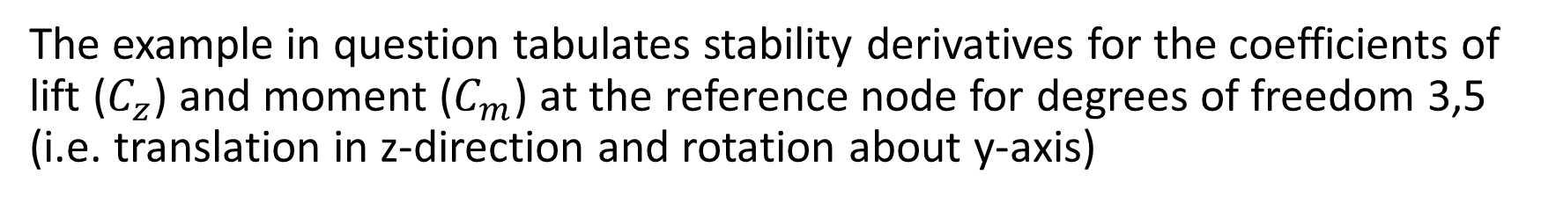
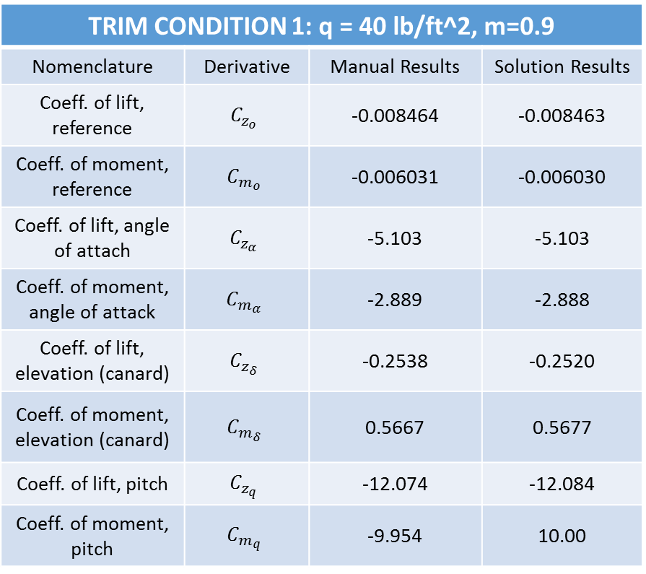
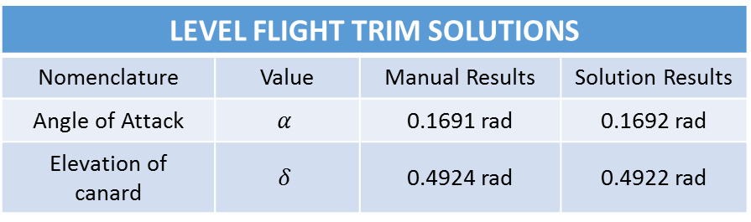
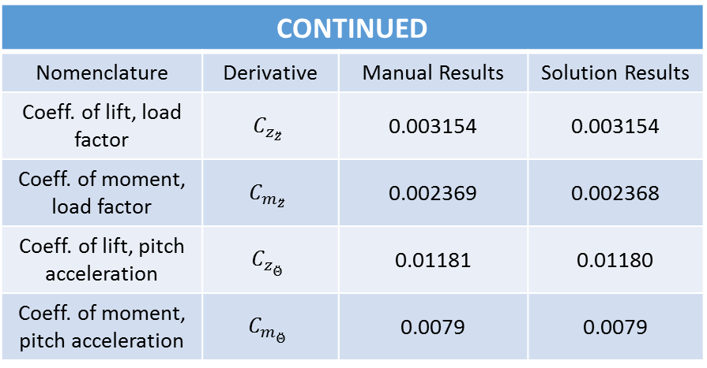
Results
The example in question tabulates stability derivatives for the coefficients of lift ($C_{z}$) and moment ($C_{m}$) at the reference node for degrees of freedom 3,5 (i.e. translation in z-direction and rotation about y-axis)
TRIM CONDITION 1: q = 40 lb/ft^2, m=0.9
Nomenclature | Derivative | Manual Results | Solution Results
Coeff. of lift, reference | $$C_{z_{o}}$$ | -0.008464 | -0.008463
Coeff. of moment, reference | $$C_{m_{o}}$$ | -0.006031 | -0.006030
Coeff. of lift, angle of attach | $$C_{z_{α}}$$ | -5.103 | -5.103
Coeff. of moment, angle of attack | $$C_{m_{α}}$$ | -2.889 | -2.888
Coeff. of lift, elevation (canard) | $$C_{z_{δ}}$$ | -0.2538 | -0.2520
Coeff. of moment, elevation (canard) | $$C_{m_{δ}}$$ | 0.5667 | 0.5677
Coeff. of lift, pitch | $$C_{z_{q}}$$ | -12.074 | -12.084
Coeff. of moment, pitch | $$C_{m_{q}}$$ | -9.954 | 10.00
CONTINUED
Nomenclature | Derivative | Manual Results | Solution Results
Coeff. of lift, load factor | $$C_{z_{\ddot{z}}}$$ | 0.003154 | 0.003154
Coeff. of moment, load factor | $$C_{m_{\ddot{z}}}$$ | 0.002369 | 0.002368
Coeff. of lift, pitch acceleration | $$C_{z_{\ddot{Θ}}}$$ | 0.01181 | 0.01180
Coeff. of moment, pitch acceleration | $$C_{m_{\ddot{Θ}}}$$ | 0.0079 | 0.0079
LEVEL FLIGHT TRIM SOLUTIONS
Nomenclature | Value | Manual Results | Solution Results
Angle of Attack | $$α$$ | 0.1691 rad | 0.1692 rad
Elevation of canard | $$δ$$ | 0.4924 rad | 0.4922 rad

Slide 7
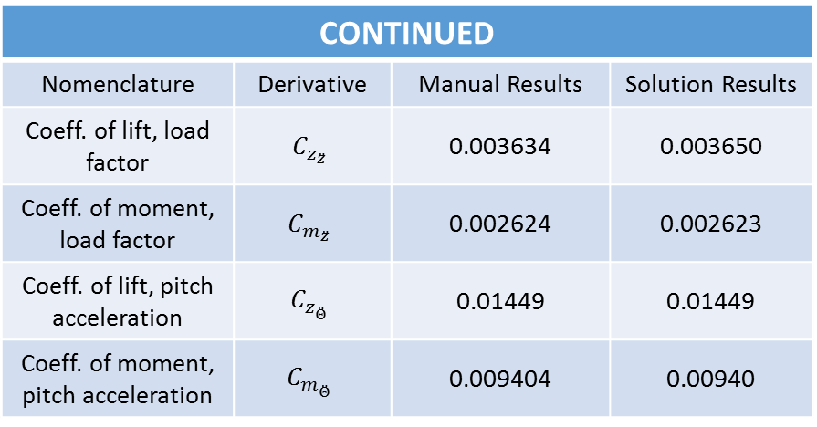
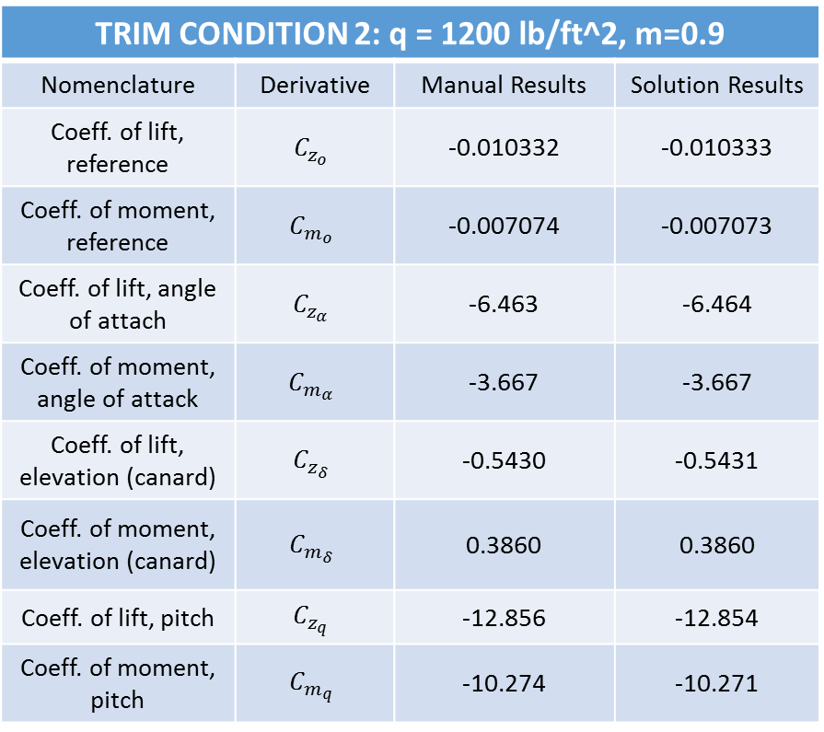

Results, Cont.
TRIM CONDITION 2: q = 1200 lb/ft^2, m=0.9
Nomenclature | Derivative | Manual Results | Solution Results
Coeff. of lift, reference | $$C_{z_{o}}$$ | -0.010332 | -0.010333
Coeff. of moment, reference | $$C_{m_{o}}$$ | -0.007074 | -0.007073
Coeff. of lift, angle of attach | $$C_{z_{α}}$$ | -6.463 | -6.464
Coeff. of moment, angle of attack | $$C_{m_{α}}$$ | -3.667 | -3.667
Coeff. of lift, elevation (canard) | $$C_{z_{δ}}$$ | -0.5430 | -0.5431
Coeff. of moment, elevation (canard) | $$C_{m_{δ}}$$ | 0.3860 | 0.3860
Coeff. of lift, pitch | $$C_{z_{q}}$$ | -12.856 | -12.854
Coeff. of moment, pitch | $$C_{m_{q}}$$ | -10.274 | -10.271
CONTINUED
Nomenclature | Derivative | Manual Results | Solution Results
Coeff. of lift, load factor | $$C_{z_{\ddot{z}}}$$ | 0.003634 | 0.003650
Coeff. of moment, load factor | $$C_{m_{\ddot{z}}}$$ | 0.002624 | 0.002623
Coeff. of lift, pitch acceleration | $$C_{z_{\ddot{Θ}}}$$ | 0.01449 | 0.01449
Coeff. of moment, pitch acceleration | $$C_{m_{\ddot{Θ}}}$$ | 0.009404 | 0.00940
LEVEL FLIGHT TRIM SOLUTIONS
Nomenclature | Value | Manual Results | Solution Results
Angle of Attack | $$α$$ | 0.00137 rad | 0.00137 rad
Elevation of canard | $$δ$$ | 0.01932 rad | 0.01931 rad

Slide 8
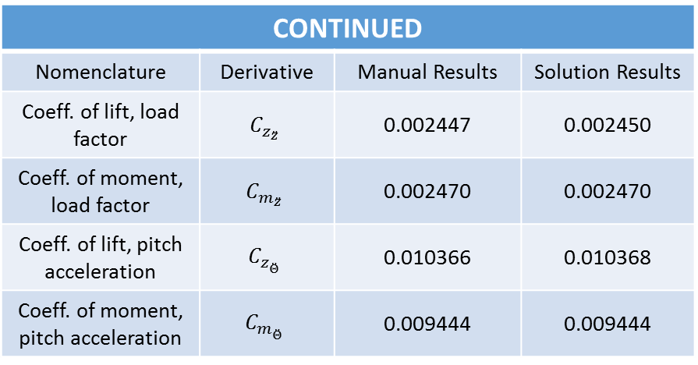

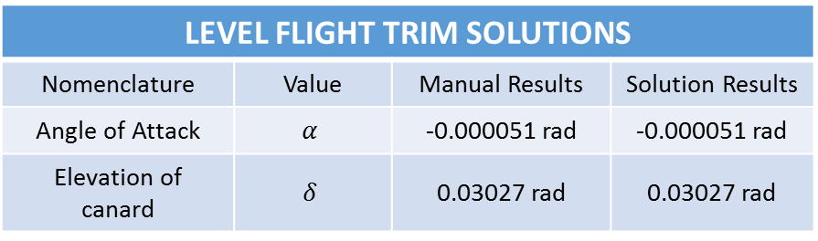
Results, Cont.
TRIM CONDITION 3: q = 1151 lb/ft^2, m=1.3
Nomenclature | Derivative | Manual Results | Solution Results
Coeff. of lift, reference | $$C_{z_{o}}$$ | -0.007172 | -0.007173
Coeff. of moment, reference | $$C_{m_{o}}$$ | -0.006959 | -0.006960
Coeff. of lift, angle of attach | $$C_{z_{α}}$$ | -4.948 | -4.847
Coeff. of moment, angle of attack | $$C_{m_{α}}$$ | -3.933 | -3.932
Coeff. of lift, elevation (canard) | $$C_{z_{δ}}$$ | -0.8386 | -0.8390
Coeff. of moment, elevation (canard) | $$C_{m_{δ}}$$ | 0.05436 | 0.05435
Coeff. of lift, pitch | $$C_{z_{q}}$$ | -7.611 | -7.610
Coeff. of moment, pitch | $$C_{m_{q}}$$ | -8.769 | -8.767
CONTINUED
Nomenclature | Derivative | Manual Results | Solution Results
Coeff. of lift, load factor | $$C_{z_{\ddot{z}}}$$ | 0.002447 | 0.002450
Coeff. of moment, load factor | $$C_{m_{\ddot{z}}}$$ | 0.002470 | 0.002470
Coeff. of lift, pitch acceleration | $$C_{z_{\ddot{Θ}}}$$ | 0.010366 | 0.010368
Coeff. of moment, pitch acceleration | $$C_{m_{\ddot{Θ}}}$$ | 0.009444 | 0.009444
LEVEL FLIGHT TRIM SOLUTIONS
Nomenclature | Value | Manual Results | Solution Results
Angle of Attack | $$α$$ | -0.000051 rad | -0.000051 rad
Elevation of canard | $$δ$$ | 0.03027 rad | 0.03027 rad

Slide 9
Future work on the sample problem
Aeroelasticity manual modelled the wing structure using beam elements. Plan is to instead model the wing using CQUAD elements and compare results between the two strategies
Additionally, this will give more practice with the splining operations used to join the aerodynamic and structural models within Nastran solution procedure.

